Slide 1
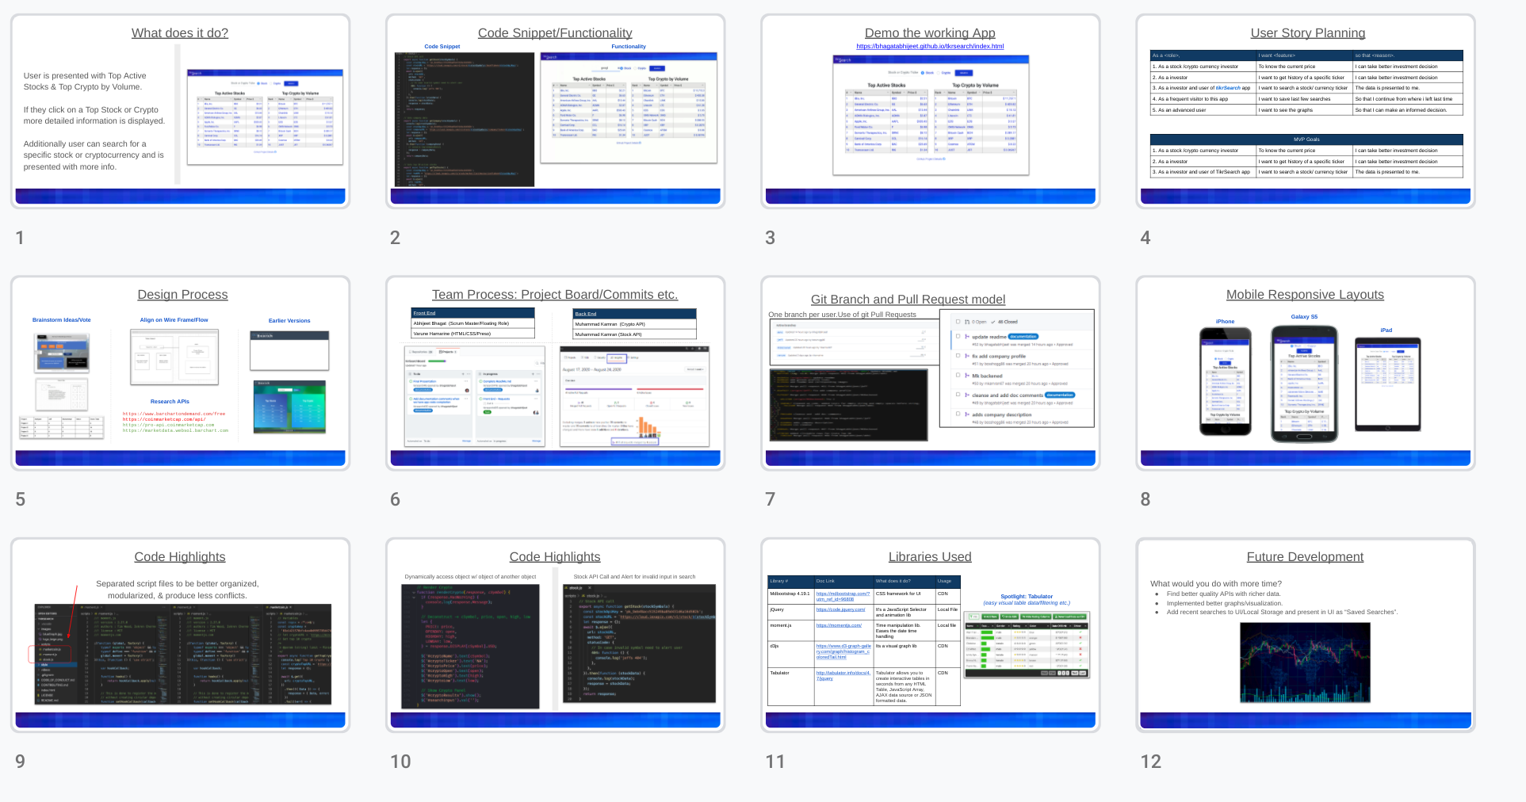
Slide Speaking Assignment (up for discussion)
Jeff
Jeff
Jeff
Varune
Varune
Varune
Abhi
Abhi
MK
MK
MK
MK

Slide 2
^{tkr}Search
Find your next blue chip stock or crypto

Slide 3
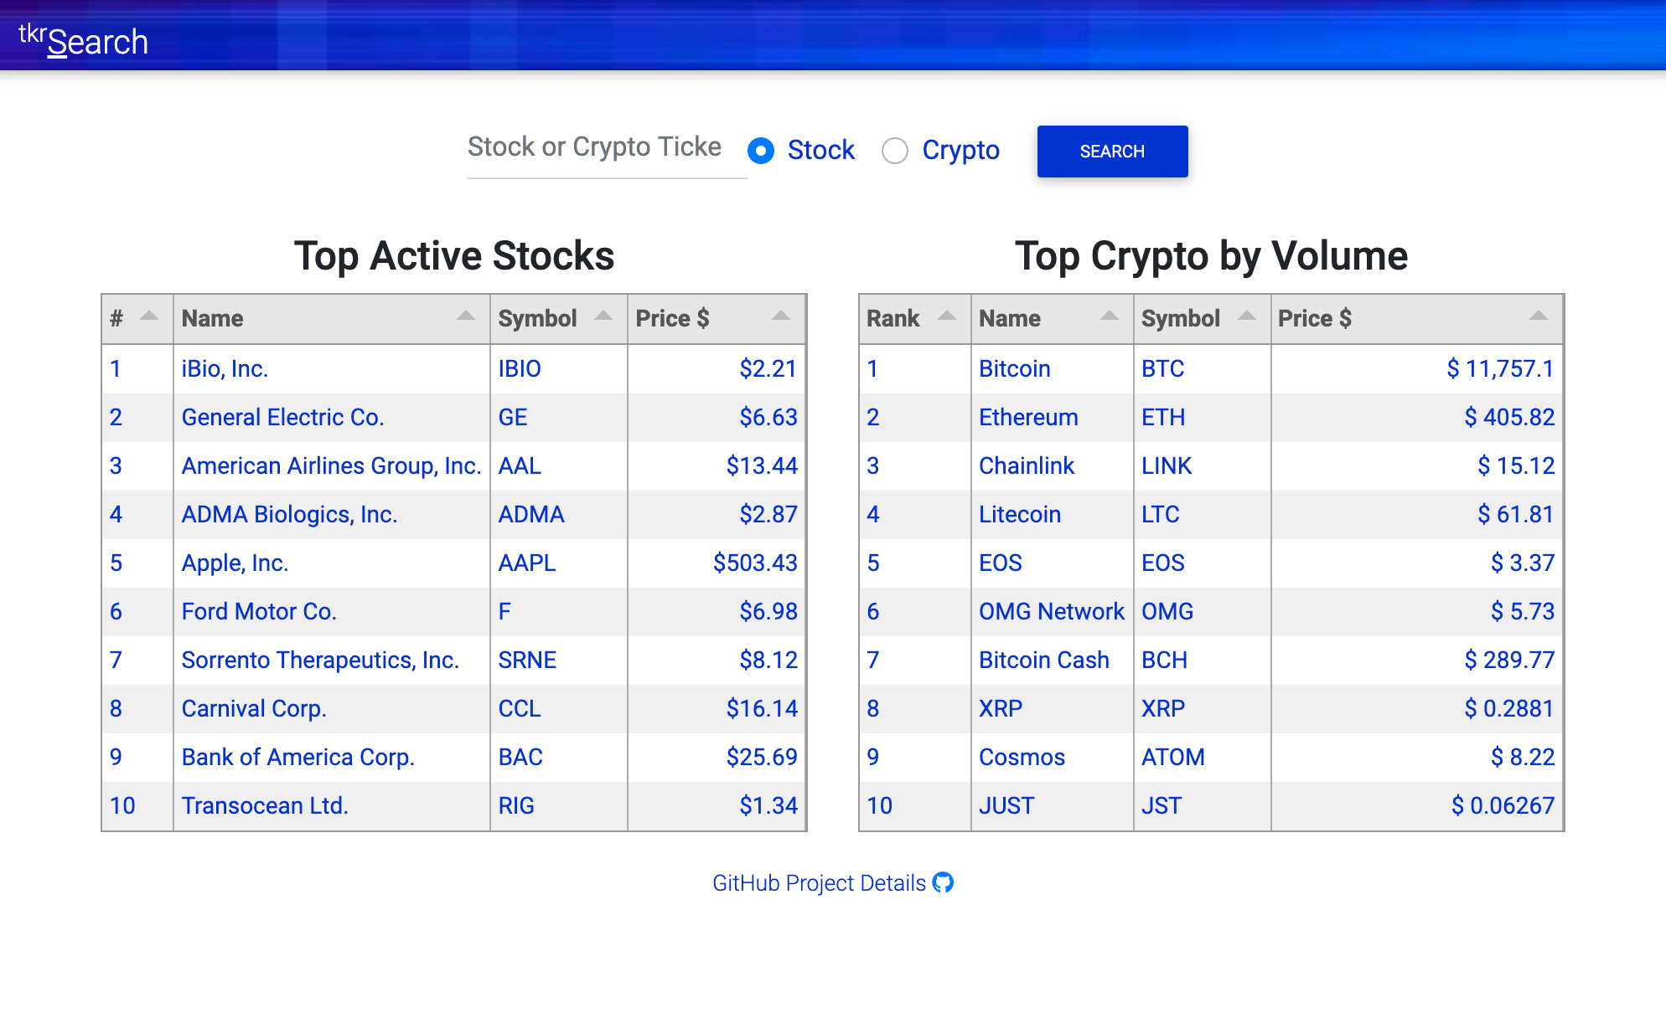
What does it do?
User is presented with Top Active Stocks & Top Crypto by Volume.
If they click on a Top Stock or Crypto more detailed information is displayed.
Additionally user can search for a specific stock or cryptocurrency and is presented with more info.

Slide 4
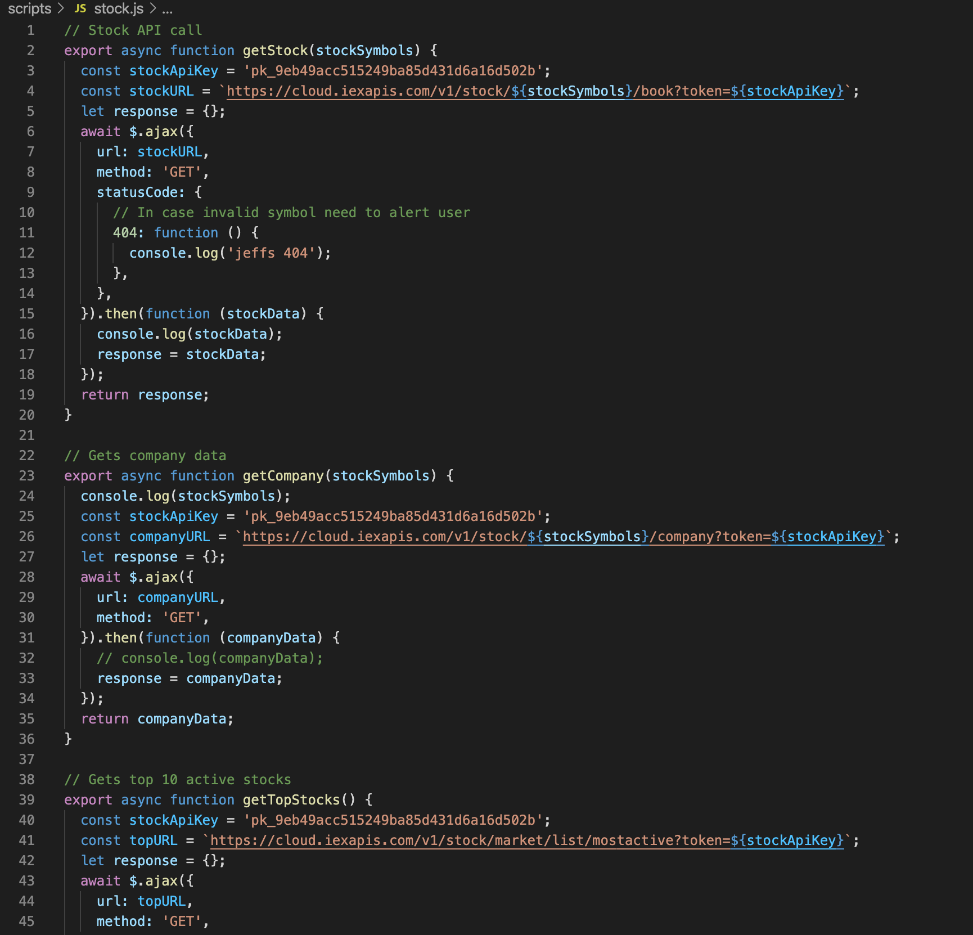
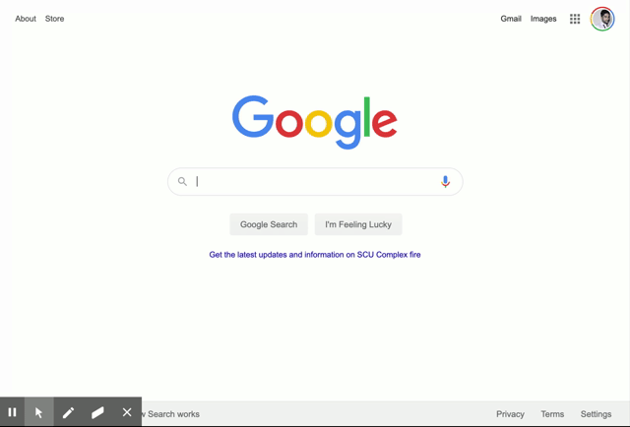
Code Snippet/Functionality
Code Snippet
Functionality
Animated gif

Slide 5
Demo the working App
https://bhagatabhijeet.github.io/tkrsearch/index.html

Slide 6
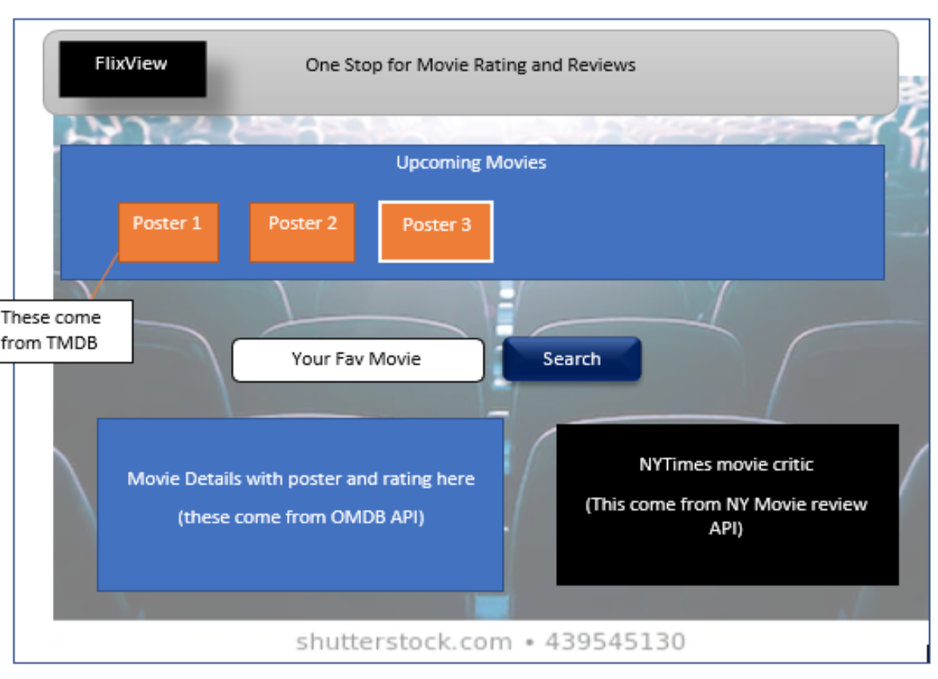
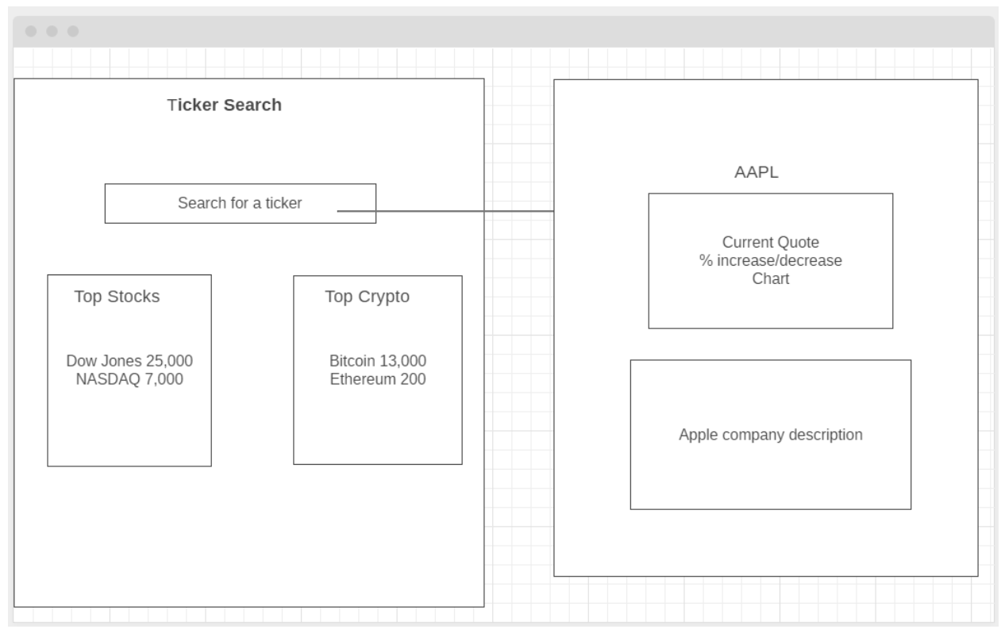
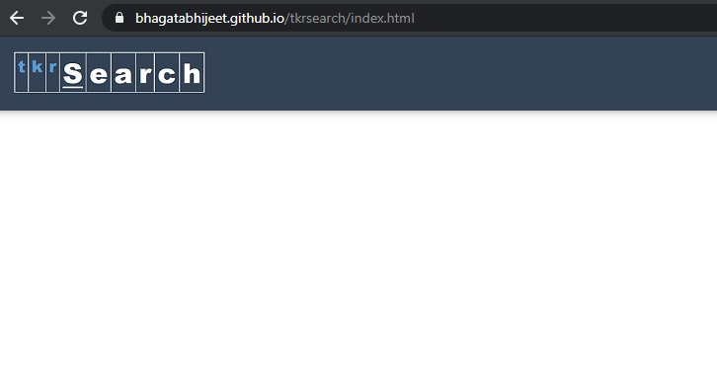
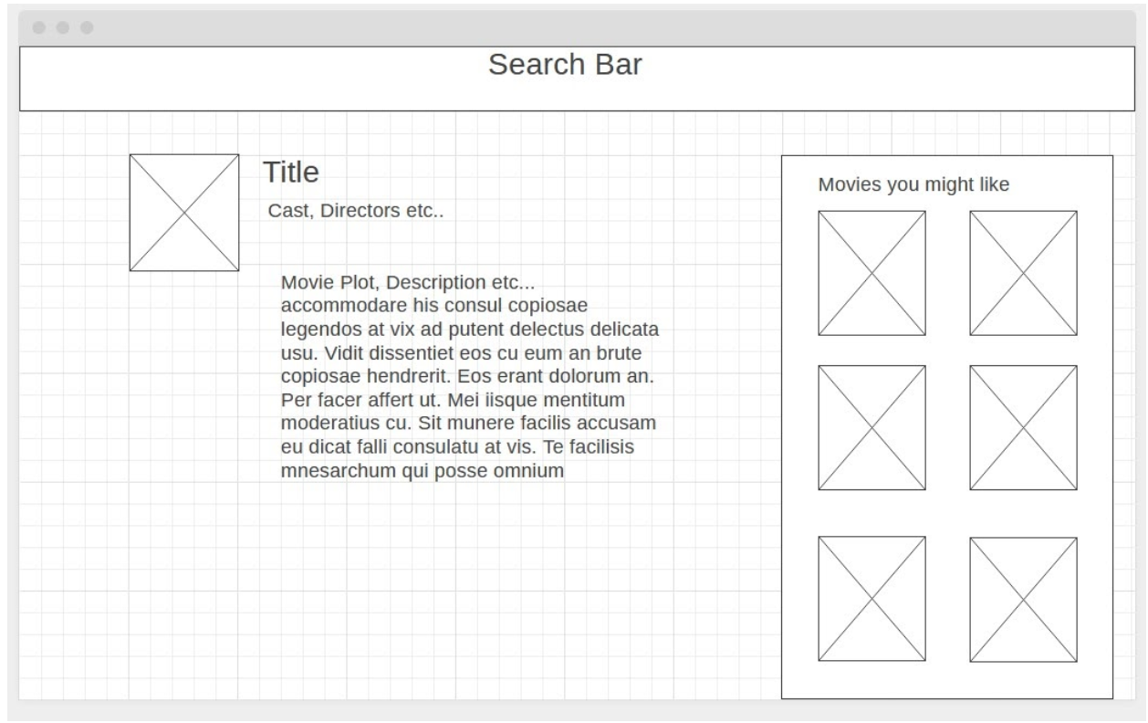
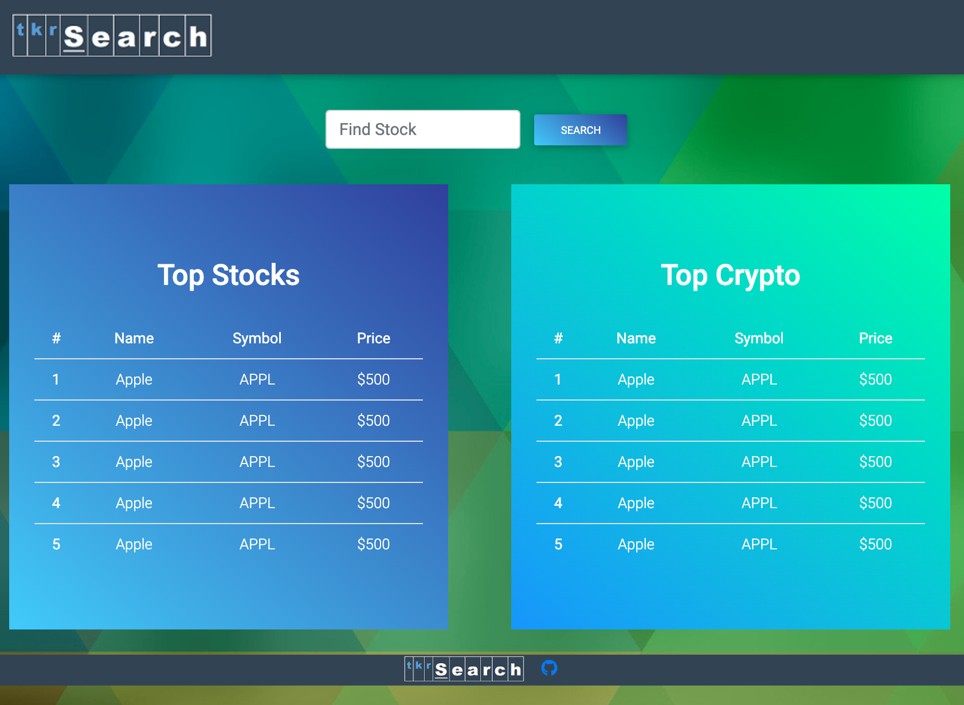
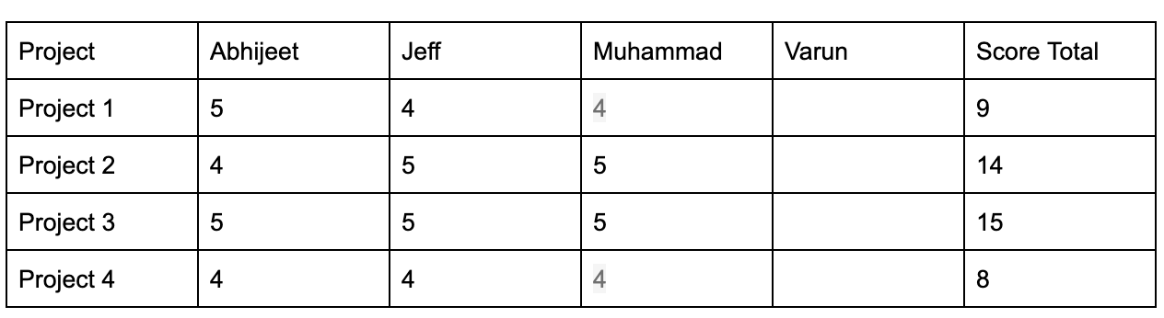
Design Process
Brainstorm Ideas/Vote
Align on Wire Frame/Flow
Earlier Versions
Research APIs
https://www.barchartondemand.com/free
https://coinmarketcap.com/api/
https://pro-api.coinmarketcap.com
https://marketdata.websol.barchart.com

Slide 7
User Story Planning
As a <role>, | I want <feature> | so that <reason>.
1. As a stock /crypto currency investor | To know the current price | I can take better investment decision
2. As a investor | I want to get history of a specific ticker | I can take better investment decision
3. As a investor and user of tkrSearch app | I want to search a stock/ currency ticker | The data is presented to me.
4. As a frequent visitor to this app | I want to save last few searches | So that I continue from where i left last time
5. As an advanced user | I want to see the graphs | So that I can make an informed decision.
MVP Goals
1. As a stock /crypto currency investor | To know the current price | I can take better investment decision
2. As a investor | I want to get history of a specific ticker | I can take better investment decision
3. As a investor and user of tikrSearch app | I want to search a stock/ currency ticker | The data is presented to me.

Slide 8
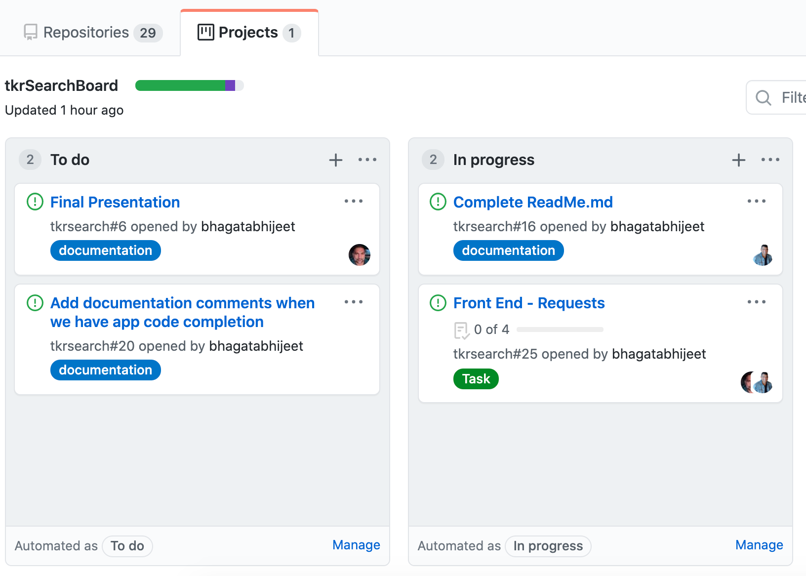
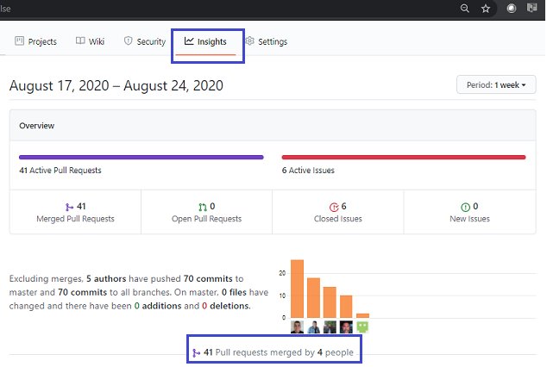
Team Process: Project Board/Commits etc.
Front End
Abhijeet Bhagat (Scrum Master/Floating Role)
Varune Harnarine (HTML/CSS/Preso)
Back End
Muhammad Kamran (Crypto API)
Jeff Hogg (Stock API)

Slide 9
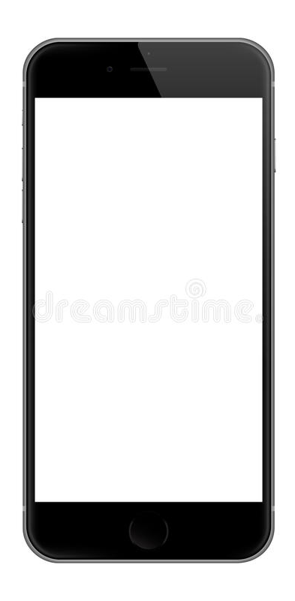
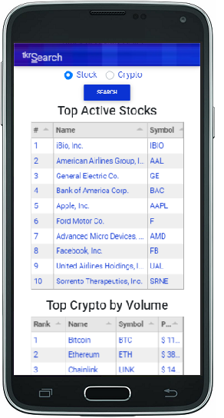

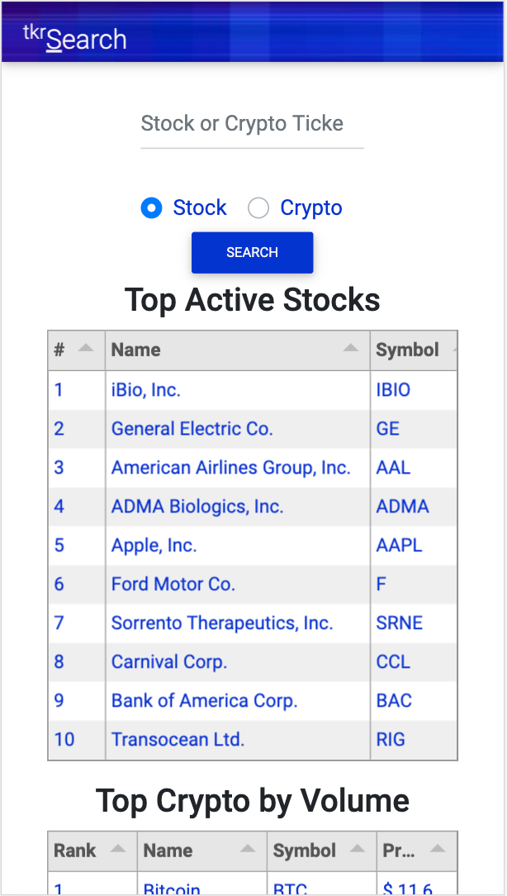
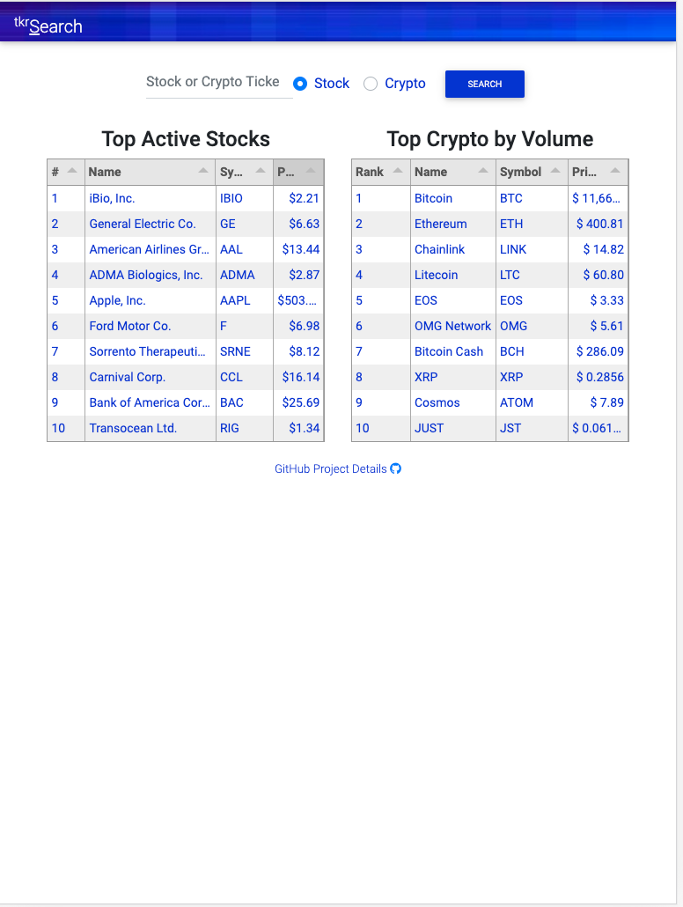
Mobile Responsive Layouts
Galaxy S5
iPhone
iPad

Slide 10
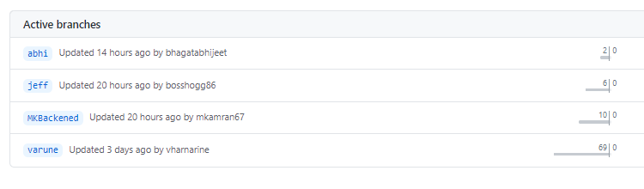
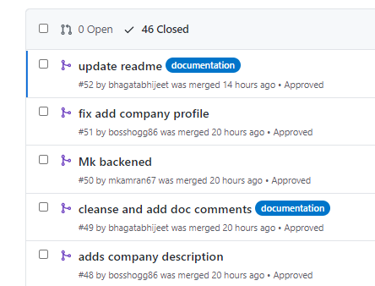
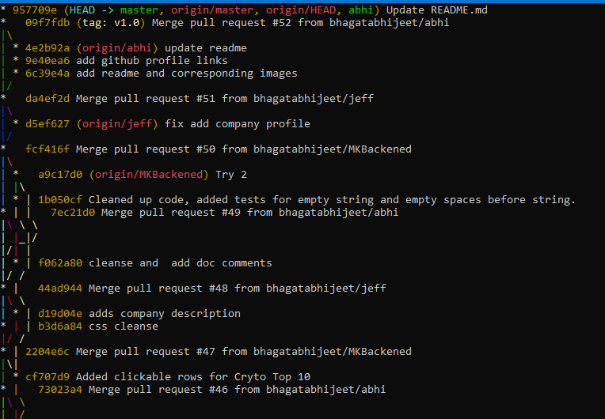
Git Branch and Pull Request model
One branch per user. Utilization of git Pull Requests.

Slide 11
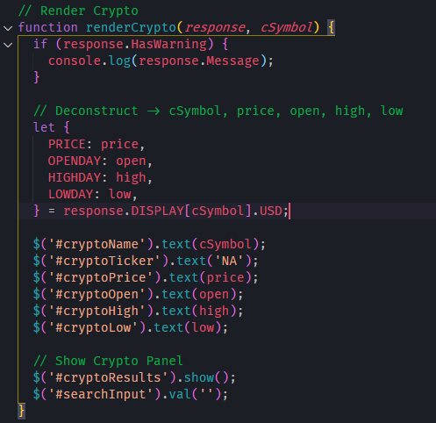
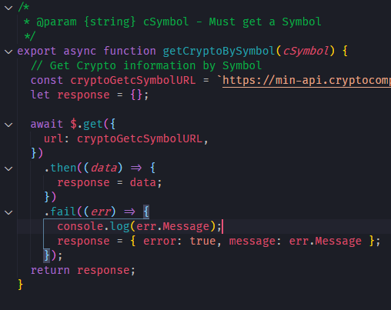
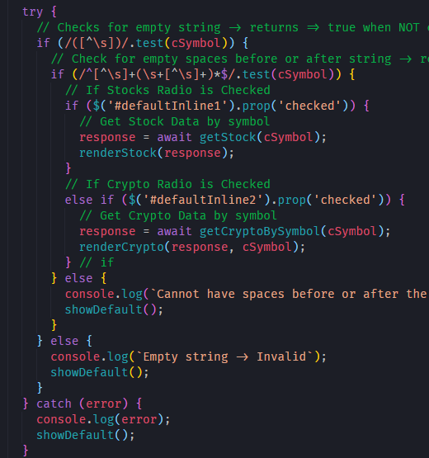
Code Highlights
Dynamically access object w/ object of another object
Redundant error handling.

Slide 12
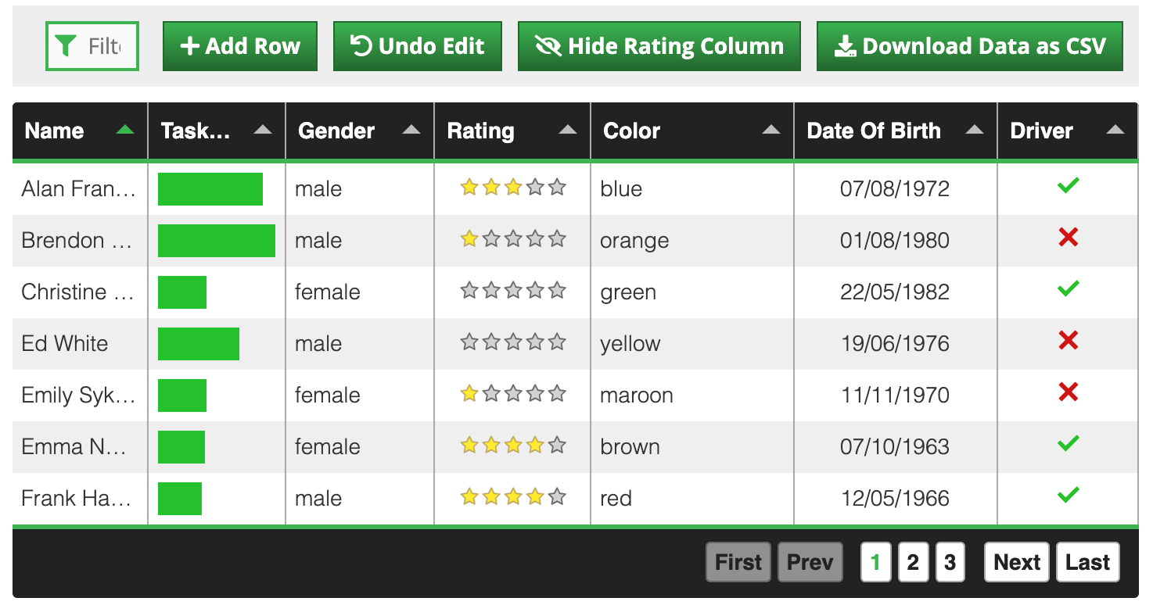
Libraries Used
Library # | Doc Link | What does it do? | Usage
Mdbootstrap 4.19.1 | https://mdbootstrap.com/?utm_ref_id=96808 | CSS framework for UI | CDN
jQuery | https://code.jquery.com/ | It's a JavaScript Selector and animation lib | Local File
moment.js | https://momentjs.com/ | Time manipulation lib. Eases the date time handling | Local file
d3js | https://www.d3-graph-gallery.com/graph/histogram_coloredTail.html | Its a visual graph lib | CDN
Tabulator | http://tabulator.info/docs/4.7/jquery | Tabulator allows you to create interactive tables in seconds from any HTML Table, JavaScript Array, AJAX data source or JSON formatted data. | CDN
Spotlight: Tabulator
(easy visual table data/filtering etc.)

Slide 13
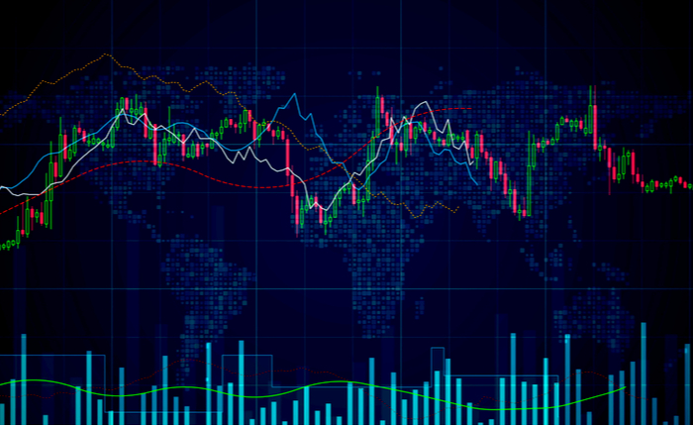
Future Development
What would you do with more time?
Find better quality FREE APIs with richer data.
Implemented better graphs/visualization.
Add recent searches to UI/Local Storage and present in UI as “Saved Searches”.

